Slide 1

Real-Time Big Data Streaming with Kafka

Slide 2
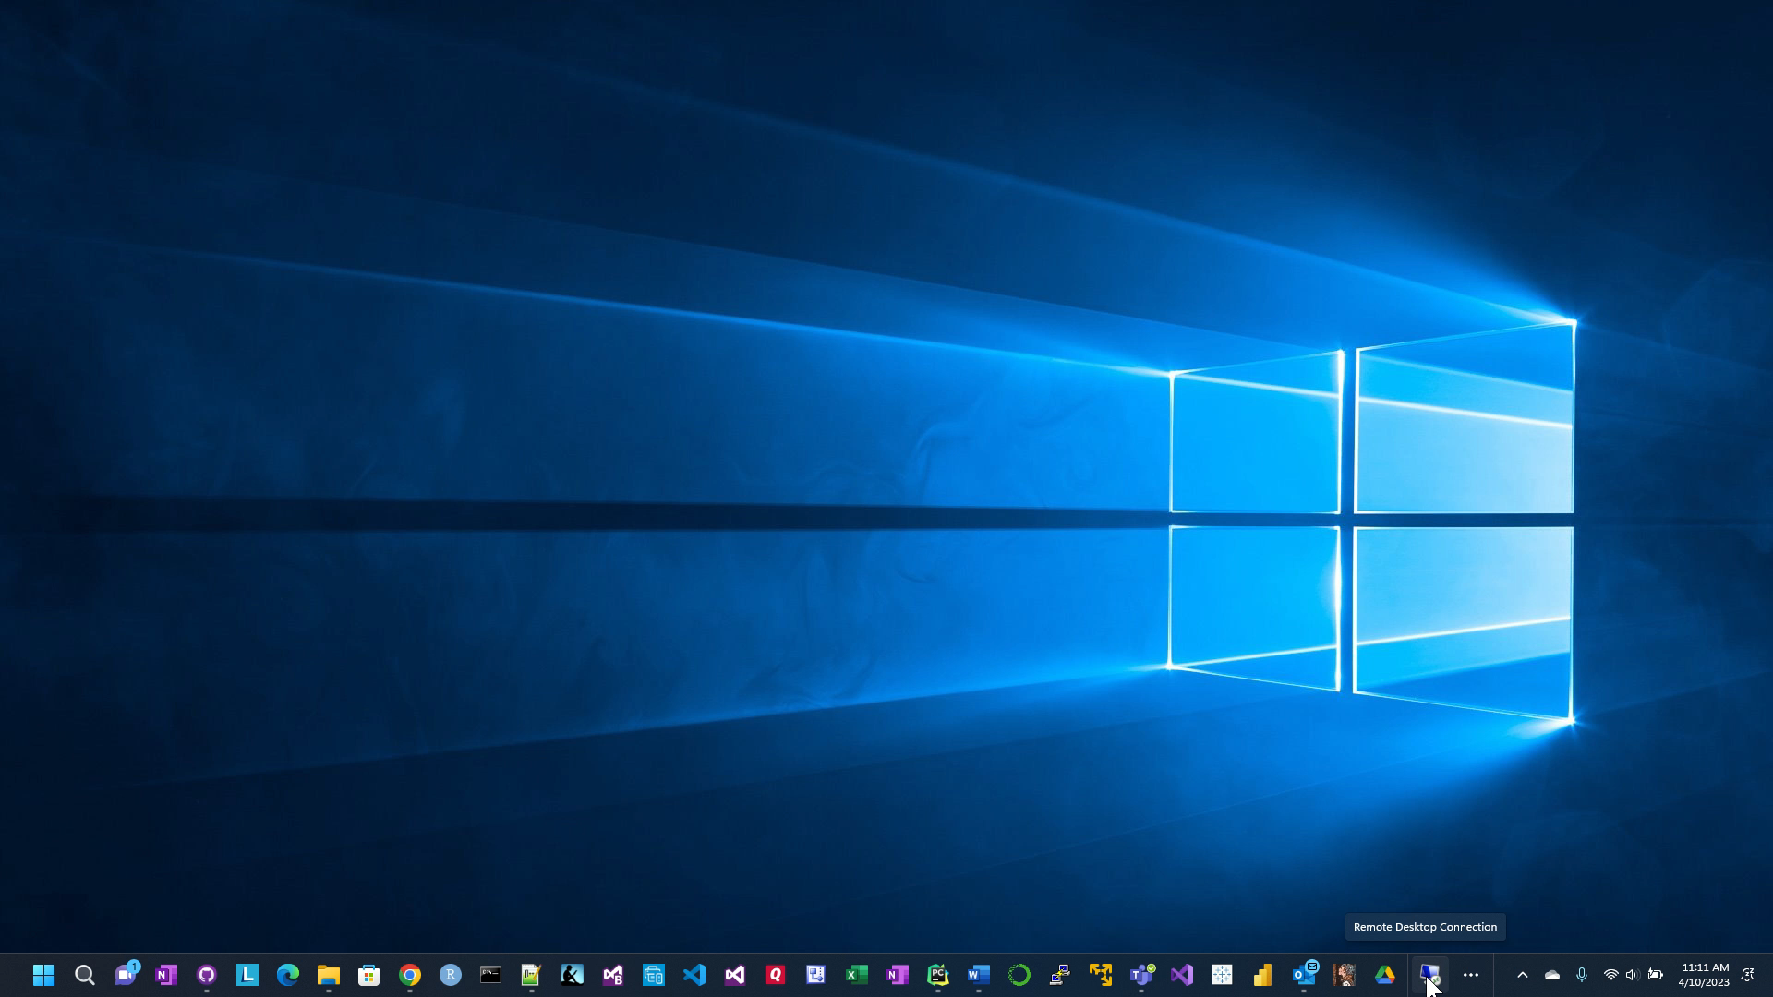

Slide 3

Conclusions
Financial Data is everywhere. With computing power of AI/ML, we can use that data to help us make calculated and low risk investment decisions
Notes:
Financial Data is everywhere. With computing power of AI/ML, we can use that data to help us make calculated and low risk investment decisions.

